Slide 1

OPIM 5601
Technical Communication for Business Analytics Professionals

Slide 2
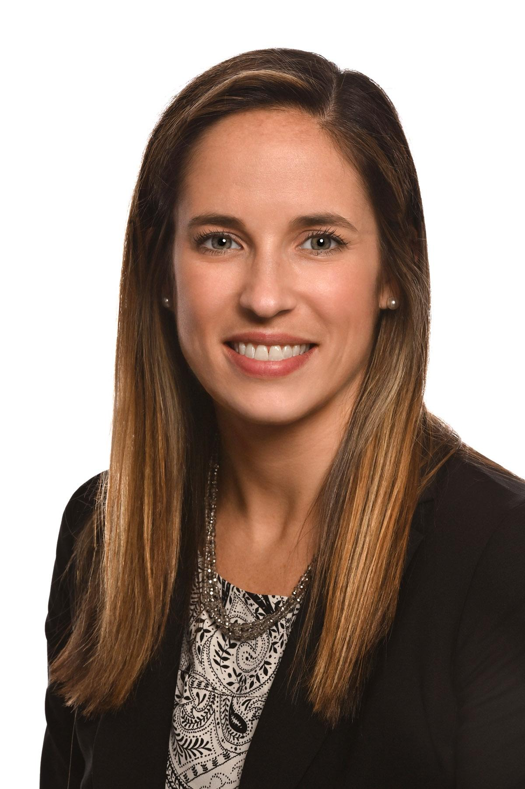
Introduction
Instructor’s Background:
Bachelor of Communication | University of Massachusetts | 2008
Master of Communication | Lasell College | 2011
BI/DW & Analytics Recruiter, HR Function | 7 years in consulting firm & other businesses | 2008 - 2015
Graduate Career Advisor | UConn School of Business | 2015 - 2019
Human Resource Manager | Environmental Systems Corporation | May 2019 - Present
Notes:
Call me Kat
What's an adjunct?

Slide 3

TA – Abhishek Gorla
Class of Spring 2019
Vice President(Education), UCONN Toastmasters Club
Vice President(Operations), Net Impact Graduate Chapter
Email ID: abhishek.gorla@uconn.edu

Slide 4

Required Course Materials
Required Materials
Harvard Business Review Coursepack: (2 articles)
Link to Coursepack in the syllabus
How to Improve Your Business Writing, by Carolyn O’Hara
How to Give a Killer Presentation, by Chris Anderson
Additional Required Reading:
http://www.inc.com/peter-economy/5-super-successful-ways-to-become-a-great-communicator.html
Optional Reading:
Textbook: Harry E. Chambers, “Effective Communication Skills: For Scientific and Technical Professionals,” Persues Publishing (2000).
http://datajournalismhandbook.org/1.0/en/index.html

Slide 5
Week | To Review In Class | Reading
Week 1 | Today’s Communication Realities Business Writing Two Minute Professional Pitches | HBR Article: How to Improve Your Business Writing
Week 2 | Building the Bridge of Effective Communication Successful Presentations Two Minute Professional Pitches (if needed) | HBR Article: How to Give a Killer Presentation
Week 3 | Influencing How your Communication is Received Public Speaking | Inc Article: 5 Super Successful Ways to Become a Great Communicator
Week 4 | Communicating Technical Information to Nontechnical People Final Presentations

Slide 6
DELIVERABLES
Evaluation | Grade % | Subject
Two Minute Speech | 10% | Two Minute Professional Introduction
Layman’s Term Assignment | 15% | Technical Concept/Idea in Layman’s Terms
Data Journalism Assignment | 15% | Draw Insights from Data
Course Reflection Assignment | 20% | Open Reflection on the Lectures or Readings
Participation | 10% | Must be present on time and engaged
Presentations | 30% | Final Presentations on Analytics
Grade % of Points
A+ 97-100
A 93-96.9
A- 90-92.9
B+ 87-89.9
B 83-86.9
B- 80-82.9
C 70-79.9
F 0-69.9
Notes:
NOT graded – proposals for final prez – talk to me in person, or email
Two Minute Speeches you’ll do today – to assess current comm skills and improve through our class learning

Slide 7

Difference between a Summary and Conclusion?

Slide 8

Why should you have to improve your communication skills?

Slide 9
Let’s hear from a BAPM Alum
https://drive.google.com/file/d/1iuYYoCWu1I8IAO0ms7bOb7-gWKQWsoX9/view
Yashwanth Musiboyina
Notes:
When’s the first time a person communicates?
Why is communication important?
Why is it so challenging to communicate technical info?

Slide 10
Today’s Communication Realities
“Regardless of the changes in technology, the market for well-crafted messages will always have an audience." — Steve Burnett, The Burnett Group
Notes:
I encourage you to share your experiences and lessons learned over time! For others who have doubts please ask questions along the way to get the most out of our learning opportunity

Slide 11
Data Analytics
Business Processes
Issues with Source Data
Organizing for Analysis
*Interpreting*
Notes:
**The work necessitates a continuous cycle of:
Understanding the business processes that are producing the data to be analyzed
Understand source data and its gaps, errors, inconsistencies, etc
Organizing different data sets into a form suitable for conducting analysis
Interpreting what can be drawn out from the data (this is the analytics)

Slide 12
Data Analytics
Business Processes
Issues with Source Data
Organizing for Analysis
*Interpreting*
Relating 1&4, Drawing Conclusions
Solution (if appropriate)
Notes:
** Relating (1) and (4), drawing conclusions, and communicating the facts and conclusions
And educating the business users to use your solution (if appropriate)
The communication is two way exchange-- a continuous process of exploration. And impacted by how effectively one communicates with people
Don’t underestimate the power of being curious, asking the question behind the question, is just as valuable as being able to share insight.

Slide 13
Data Journalism / Data Storytelling
Connect with people
Try to convey one idea
Keep it simple
Explore things you know best

Slide 14

Communication is an art, not a science.
Biggest challenge facing organizations – EFFECTIVE COMMUNICATIONS
Challenges even greater in the IT space due to complexity
No “one size fits all” to achieve most effective communication – it’s a delicate combination
Critical to have good communication since Analytics and Project Management Professionals have to influence / persuade projects and decision makers
Notes:
Not just in companies, but between friends, families, relationships…
No one is an expert, even fine communicators can improve

Slide 15
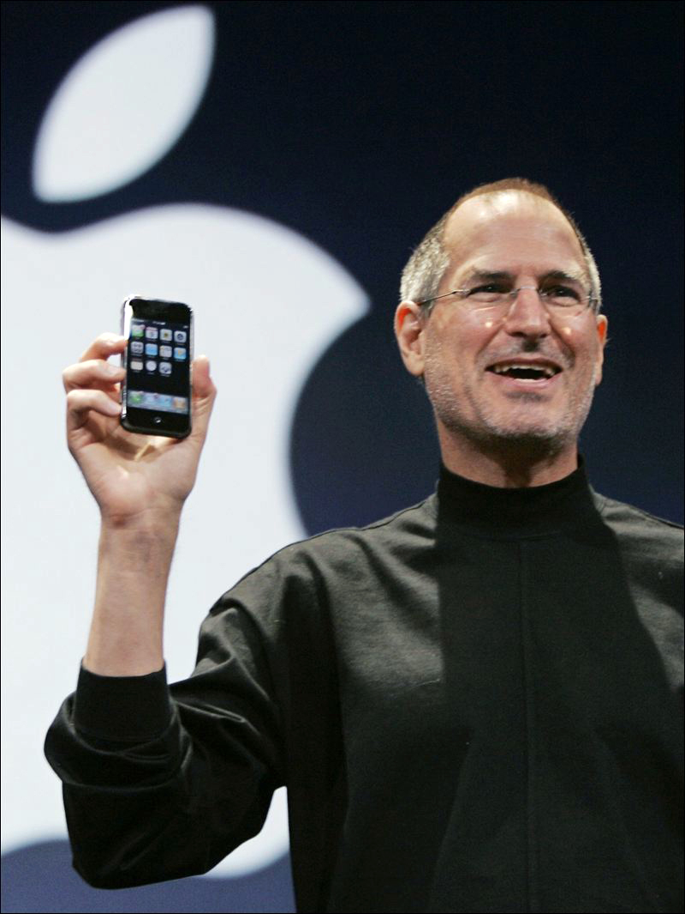
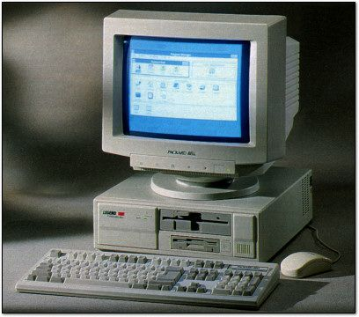
PAST EXPECTATIONS: Technical gurus hitting keyboards in the dungeons of corporate America. NEW EXPECTATIONS: Sell it to the decision makers!
Notes:
…That used to be the role of managers, but now you’ll work in field with high demand for collaboration. Many roles (especially in consulting) will be working with external and customers internal, to influence the direction of a project. All of these other professionals that you’ll work with have diverse backgrounds which you must be comfortable getting exposure to.

Slide 16
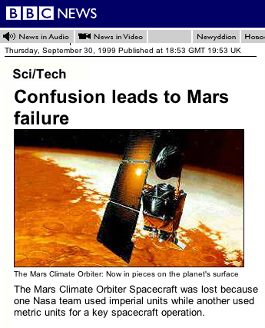
Complex Communication Challenges
Justification of project or phases
Increased competition for internal and external resources
Elevated communications skills aid in securing such needs
Miscommunication risks are evident in daily projects
Example: NASA Mars Climate Orbiter Spacecraft
Notes:
**POSITIVE: you get increased visibility to managers, leaders in the organization, and decision makers.
Technology professionals have exposure that wasn’t necessary a few decades ago. This can be extremely advantageous in your learning opportunities and career growth potential.

Slide 17

6 Critical Communication Realities
(1) More Task-Oriented than People-Oriented
Hard Skills / Black & White: measurable, primarily done alone
Soft Skills / Gray Area: can’t quantify, dependent on interpersonal skills often
Need to be more in tune with the task at hand AND the big picture of the business environment.
Notes:
…You can give the best presentation in the world based on your subject matter expertise, but if the audience doesn’t get it then it’s all lost. You must make sure to connect with your audience through such soft skills.

Slide 18

6 Critical Communication Realities
(2) Dedicated to the Work you do
Hard to separate yourself from your work, feeling of “I am what I do” and therefore it is hard to take criticism
Feedback is necessary for growth and improvement
Communication will provide open dialog to discuss ways to change and strengthen work over time
Don’t reject feedback -- embrace constructive criticism and view as a chance to develop your presentation skills
Notes:
Often technical people feel that their work is a product of their intellect and becomes their “baby”

Slide 19

6 Critical Communication Realities
(3) Motivated for Perfection – what do THEY want?
Over-engineering or Overbuilding often take place
(just because you can build something fancy doesn’t mean you have to always!) Often can be eliminated by communication to ensure requirements are thoroughly understood
Hard to take into consideration the restraints on projects which are critical and could impact quality.
Examples: time, budget, resources…

Slide 20
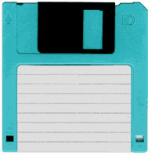
6 Critical Communication Realities
(4) Obsolete Strategies
Information Hoarding – just because you’re the SME doesn’t mean you can keep others out of the loop
“Turfism” – today’s professional goals are more focused on collaboration and cooperation
For your own success you must embrace communication
Political Astuteness – for your project success and your own professional growth you must embrace politics. Starts with being politically aware, and involved in the conversations
Notes:
…Don’t worry – if you share information others will not be able to do your job, your level of skill is hard to replicate

Slide 21

6 Critical Communication Realities
(5) Logical Thought Leads to Miscommunication
Mustn’t come across as abrasive or curt with others though you are trying to be matter-of-fact and detailed. Misconstrued often as arrogant or superior
Typically comes from being overly focused on the content rather than the recipient of the information
Your content will often be overly complex (nature of IT) – if you seem to be frustrated of have lack of concern when delivering your receiver will shut down and not hear the rest of the message even if the content is strong
Not what you say, but how you say it
Notes:
…Depth of info can be overwhelming to others
NOT often the case when speaking to other IT professionals – you’ll often enjoy debating or getting deep into the details because you’re on the same page – so you communicate very clearly and efficiently with them.
In fact, you often benefit from such conversations
Think about how ONE message is received TWO different ways

Slide 22
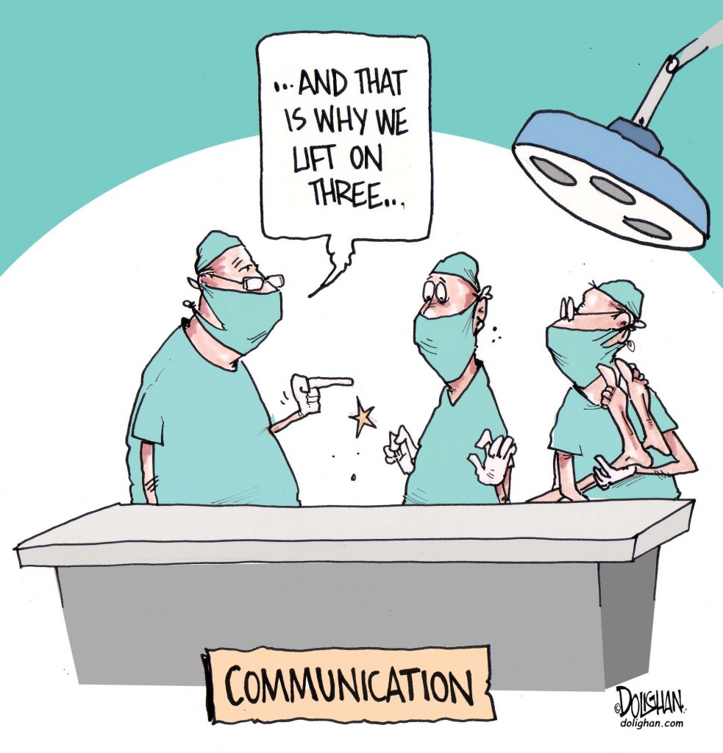
6 Critical Communication Realities
(6) Expanded Audience
Keys to success with any audience:
1- establish expectations, determine needs, align with actual capabilities, how will both parties measure success
2- strengthen summarizing skills, and deliver timely feedback
Customer Service Skills – discuss with your customer how, what, and when you’ll provide feedback
Find mutual agreement – often have to negotiate for
Notes:
…IT professionals are not just talking to their managers or other IT professionals anymore, must be comfortable to talk to members of all business groups.

Slide 23

For Long-term Success
Understand the business!
Many aspects of the business effect technical work and each group thinks about their business differently. This poses a challenge but also an opportunity for IT professionals to learn.
Get exposure or training to multiple lines of business since they all impact your work.
Know how you fit into the big picture!
Strengthened communication skills will help broaden your understanding and be skills you can leverage to grown within the organization.
Notes:
…Next week we will start to discuss communication as a process and how to ID specific procedures to upgrade your communication skills.

Slide 24
6 Critical Comm. Realities - DISCUSSION
(1) More Task-Oriented than People-Oriented
(2) Dedicated to the Work
(3) Motivated for Perfection
(4) Obsolete Strategies
(5) Logical Thought Leads to Miscommunication
(6) Expanded Audience

Slide 25

Business Writing
“Clear writing means clear thinking” –Marvin Swift

Slide 26

Tips for Stronger Writing
Be observant – when others write well think what elements you can mimic
Think first… what’s the point to your writing? How will you be influential?
Practice will never make perfect but will improve greatly!
You could consider creating an outline
Notes:
**You’ll probably be responsible for writing more as you work your way up in companies
…What do you want others to know. If you’re not crystal clear on what you want the take always to be then your audience won’t know either.

Slide 27

Think Before You Write
Don’t just dive in, what is the point you’re trying to make?
Don’t make me read half your email/paper to then understand the point
Should be organized and have structure so thoughts flow
Often “stream of consciousness” writing leads to repeating yourself to emphasize points… instead learn to emphasize points with substance

Slide 28
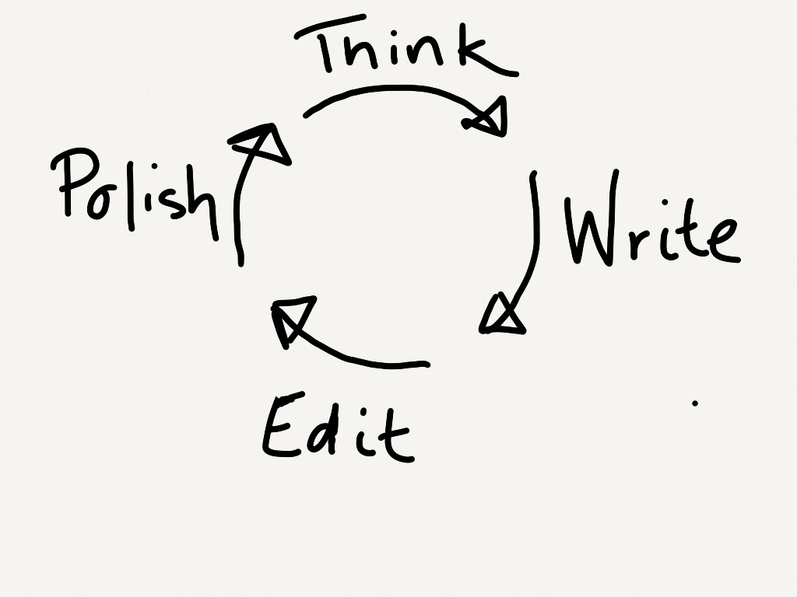
Be Direct
Overly wordy writing makes readers tune out
“Cut the fat” – journalism or press releases
Reread your writing and thank about which words are “filler” or “fluff”
Avoid grandiose word choice – simple doesn’t mean stupid, it’s effective
Write in summarizing form unless SPECIFICALLY detailing on purpose
Notes:
***Image first - Often a cyclical process – it’s rarely perfect at first
….use big words because you want to sound smart in grad school….

Slide 29
What reading level is widely accepted as the BEST LEVEL OF WRITING for common purpose?

Slide 30
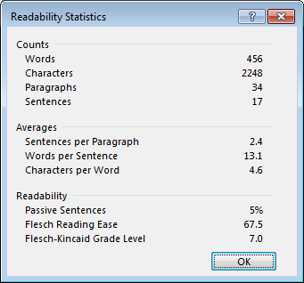
Flesch–Kincaid Readability
Raw Score | Difficulty Level |  | Representation
<30 | Very Difficult | Graduate Student | Scientific Journal
30-50 | Difficult | Undergrad | Academically Oriented
50-60 | Fairly Difficult | 10th-12th grade | Quality Magazine
60-70 | Standard | 8th-9th grade | Good article
70-80 | Fairly Easy | 7th grade | Science Fiction
80-90 | Easy | 6th grade | Pop Fiction
90-100 | Very Easy | 5th grade | Comic Book
Notes:
**The best reading level to write at is middle school – 6 to 8 grade
Barrier-free, quick read, well comprehended by all - More than that leads to skimming or skipping!
…WHATS JARGON?

Slide 31
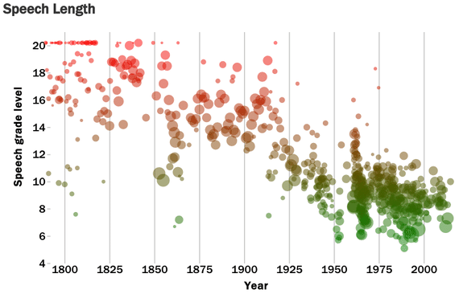
Presidential Speeches Through History
Rank | President | Words per sentence | Flesch-Kincaid Grade Level
1 | John Kennedy | 24.4 | 13.2
2 | Dwight Eisenhower | 20.9 | 12.8
3 | Franklin Roosevelt | 24.4 | 12.5
4 | Richard Nixon | 23.5 | 11.6
5 | Gerald Ford | 19.3 | 11.2
6 | Jimmy Carter | 19.7 | 10.8
7 | Harry Truman | 19.0 | 10.6
8 | Lyndon Johnson | 20.3 | 10.4
8 | George W. Bush | 19.0 | 10.4
10 | Ronald Reagan | 19.6 | 10.3
11 | Bill Clinton | 19.0 | 9.5
12 | George H.W. Bush | 17.4 | 8.6
13 | Barack Obama | 16.7 | 8.5

Slide 32
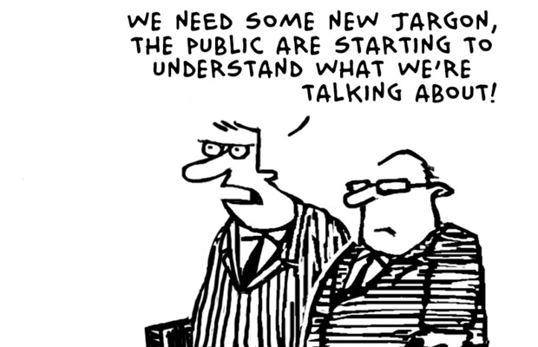
Jargon
Appropriate but not common vernacular of most audiences
Your message will be lost if not properly communicated – leads to mixed messages
Only valuable when spoken to other specialists
“Give it to me in plain English”
“Speak in layman's terms”

Slide 33
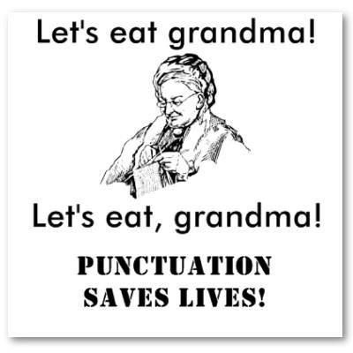
Proofread and Edit
Try going through as if you were the reader – does it make sense to you?
Speak out loud – good way to find run on sentences or grammatical errors
Ask for feedback from another colleague or peer – take constructive criticism
Notes:
… editing your own work is a learning process and helps you improve in time

Slide 34

Practice!
As you get more accustomed to editing your own work you’ll start to find your style and flow
Be aware of strong writing you read, try to emulate techniques that make sense to you
DO: plan ahead! Be short and sweet! Avoid fancy words

Slide 35
BEFORE AND AFTER
Hi Kat,
I still have some questions, can I come by your office, and ask you questions? I have a class today that goes until 1pm so I could come to your office a few minutes later if that’s okay with you. I’m struggling profusely because I have a potpourri of experiences and need your help to know what’s best.
Actually, I’ll need lunch after class so can I come to your office at 2:00pm instead of 1:00pm?
Hi Kat,
I have additional questions from class today. Can I make an appointment at 2:00pm to review them?
Thanks for your time.
Notes:
Context? Why do you want to meet?
Extra words
To the point – be direct

Slide 36
7 C’s of Communication
Clear
Concise
Concrete
Correct
Coherent
Complete
Courteous
Be clear about your goal or the message you are trying to communicate.
The audience wants to be on the same page with you and know what to expect.
Be direct and to the point so others do not have to make assumptions.
Notes:
Anyone ever heard of these?
They can vary slightly

Slide 37
7 C’s of Communication
Clear
Concise
Concrete
Correct
Coherent
Complete
Courteous
Stick to the point and avoid complicating the message.
You don’t need “fancy words” to strongly communicate your ideas.
Provide context when necessary, but don’t repeat yourself if it will cloud your point.

Slide 38
7 C’s of Communication
Clear
Concise
Concrete
Correct
Coherent
Complete
Courteous
Use details that are necessary to focus the audience.
Too many details can distract the audience.
You must be concrete so that the receiver is clear on what you’re telling them.
Notes:
Don’t just add info to add info or sound smart – stay on point!

Slide 39
7 C’s of Communication
Clear
Concise
Concrete
Correct
Coherent
Complete
Courteous
To properly communicate via any style or to any audience you must be correct.
Did you check the names? Titles? Facts? Spelling? Grammar?
You must correctly identify your audience to know their level of familiarity on the subject.

Slide 40
7 C’s of Communication
Clear
Concise
Concrete
Correct
Coherent
Complete
Courteous
Coherent communication is logical. The audience must be able to follow along with the points you make and conclusion you’re leading them to.
If not done coherently you risk miscommunicating to the audience more often or easily.

Slide 41
7 C’s of Communication
Clear
Concise
Concrete
Correct
Coherent
Complete
Courteous
If you have communicated completely then the audience understands the next steps or action necessary to take.
Your communication is complete if you’ve been as relevant as possible.
Simple errors can be avoided if you’re complete.

Slide 42
7 C’s of Communication
Clear
Concise
Concrete
Correct
Coherent
Complete
Courteous
Courteous communication is open, authentic, and pleasant.
Other C’s of Communication:
Strong communication can also be considered CREDIBLE and/or CREATIVE.
Notes:
Genuine and honest
…QUESTIONS?

Slide 43
Break

Slide 44
Toastmasters – Tips on Public Speaking

Slide 45
Two Minute Professional Pitches
Students will introduce themselves to the class by giving a two-minute speech.
Your speech will need the following criteria: (2 points each)
At least a 2-minute introduction in front of the class
with 2 or more unique selling points about yourself as well as
1 self-identified area of improvement that you plan to work on while at UConn
Organized flow without disjointed thoughts or non-sequiturs
Overall: creative and original style (Feel free to let us see your personality!)
Notes:
Each topic can only be done twice

Slide 46
Final Presentation Teams
Check Blackboard to see you members of team for final Presentations
Take time to think of proposal – DUE Next week!
Recommended to submit sooner

Slide 47
Appendix
Reading Level Guide –
In Word 2016
Click the File tab, and then click Options.
Click Proofing.
Under When correcting spelling and grammar in Word, make sure the Check grammar with spelling check box is selected.
Select Show readability statistics.
After you enable this feature, open a file that you want to check, and check the spelling. When Outlook or Word finishes checking the spelling and grammar, it displays information about the reading level of the document.
Determined with a formula based on number of syllables, words, sentences, and structure. Also use: https://readability-score.com/

Slide 48
Appendix
Jargon – “special words or expressions that are used by a particular profession or group and are difficult for others to understand”

